Slide 1
Algorithms Lecture 2
Module Leader : Dr. Mostafa Salama
Module Code: Analysis of Algorithms
Module Code: 16CSCI01I
Module Aim:
Analyse the amount of resources needed to solve a given computational problem.
Compare the efficiency of using different algorithms in addressing and solving the problem.
Module Content:
Principles of Algorithm Analysis [Brute Force algorithms]
Greedy Algorithms.
Divide and Conquer Algorithms.
Dynamic Programming Algorithms.
Genetic algorithms
Module Evaluation:
Assignment :20%, deliver in Sunday week 5
Class Test :30%, on week 7
Final Exam :50%
Lecture notes : 2

Slide 2
Greedy [Definitions]
Greedy algorithm strategy choose the best solution that seems at the moment is the best one we go with. You take the best you can get right now, without regard for future consequences. You hope that by choosing a local optimum at each step, you will end up at a global optimum.
Example:
Kruskal’s algorithm for finding a minimum-cost spanning tree
Always tries the lowest-cost remaining edge
Prim’s algorithm for finding a minimum-cost spanning tree
Always takes the lowest-cost edge between nodes in the spanning tree and nodes not yet in the spanning tree

Slide 3
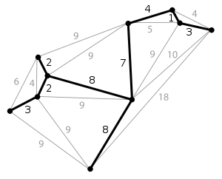
Greedy [Kruskal MST]
A tree is a graph that does not contain any cyclic connected nodes.
A spanning tree of an undirected graph G is a subgraph of G that is a tree containing all the vertices of G.
In a weighted graph, the weight of a subgraph is the sum of the weights of the edges in the subgraph.
A minimum spanning tree (MST) for a weighted undirected graph is a spanning tree with minimum weight.
Kruskal algorithm start by selecting the edge whose weight is the minimum, then select another unselected edge whose weight is minimum and does not cause a cyclic connection.

Slide 4
Greedy [Kruskal MST]
V is set of vertices
E is set of edges
Every vertex v has a weight w
T is an empty spanning tree
n is number of vertices in V
Procedure Kruskal (V, E)
Begin
T = {};
n = |V|
1. Sort the edges of E in an ascending order according to weight w;
2. While |T| < n
Remove (u,v)_{edge} of lowest weight w from E
if( ((x,u)_{edge} ∈ T ) && ((y,v)_{edge} ∈ T) )
disregard (u,v)_{edge}
else
add (u,v)_{edge} to T
return T;
End Kruskal;
Greedy concept to select first suitable sub-solution
This condition checks if adding the edge to the spanning tree T would form a cycle?

Slide 5
Greedy [Kruskal MST Analysis]
Kruskal algorithm
This algorithm is mainly two steps:
Step one: Sort the vertices of size n . The minimum complexity for sorting is n.log₂(n)
So the complexity of sorting (step 1) is O( n * log₂(n) )
Step two: The while loop will iterate for e times in the worst case where e is the number of edges such that e= |E| ,
So the number of steps of this loop is e.
And Since G is a connected graph ,
Then e ≥ n-1 and e ≤ n²
Then log e ≤ log₂ n²
Then e ≤ 2 * log₂ n
Then e is O( log₂ n )
So the complexity of this loop (step 2) is O(log₂ n)
These two steps are processed sequentially (not concurrently),
Then the summation of the complexity of both steps is equivalent to the complexity of the whole algorithm.
Then total complexity is n * log₂ (n) + log₂ (n) = O( n * log₂ (n) )
Then the complexity of Kruskal’s algorithm is : O( n * log₂ (n) )

Slide 6
Greedy [Kruskal MST Analysis]
Sort the edges by increasing edge weight
F
3
C
edge | d_{v}
(D,E) | 1
(D,G) | 2
(E,G) | 3
(C,D) | 3
(G,H) | 3
(C,F) | 3
(B,C) | 4
edge | d_{v}
(B,E) | 4
(B,F) | 4
(B,H) | 4
(A,H) | 5
(D,F) | 6
(A,B) | 8
(A,F) | 10
10
A
4
3
√
x
8
4
x
5
B
6
√
D
x
x
4
4
H
√
1
√
2
3
√
G
E
3
√
Final Result spanning tree is
F
3
√
C
A
3
4
5
B
D
H
2
1
3
G
E

Slide 7
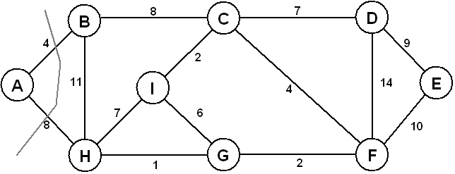
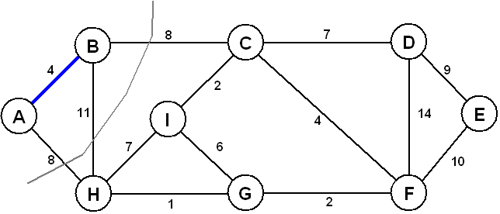
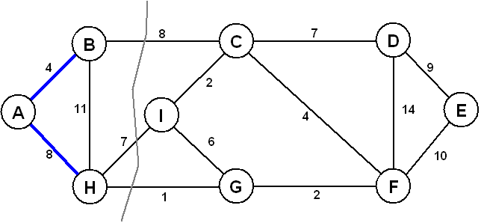
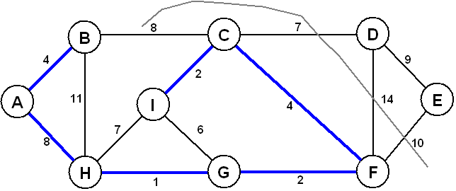
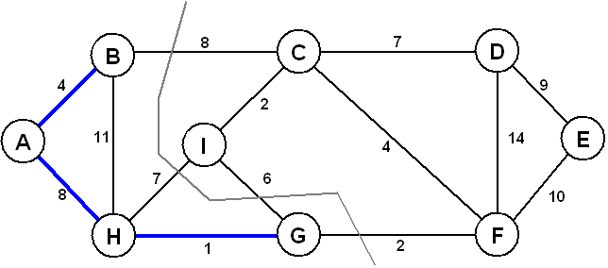
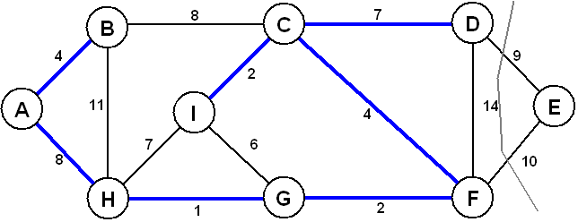
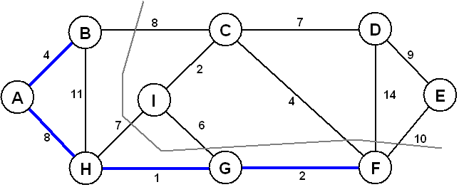
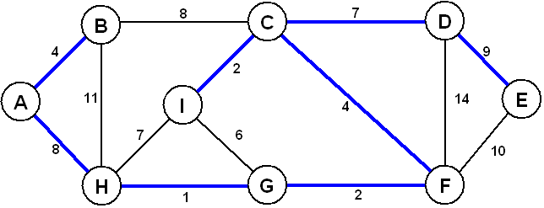
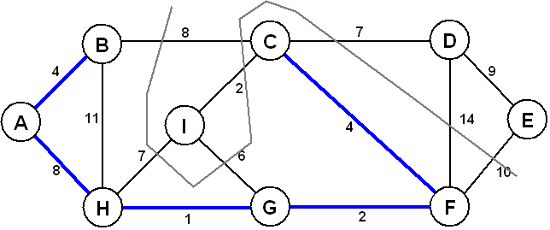
Greedy [Prim’s MST]
1
Prim Algorithm
The idea behind Prim’s algorithm is simple, a spanning tree means all vertices must be connected. So the two disjoint subsets (discussed above) of vertices must be connected to make a Spanning Tree.
Prim’s algorithm,
Find a cut (of two sets, one contains the vertices already included in MST and other contains rest of the verices),
Pick the minimum weight edge from the cut and include this vertex to MST Set (the set that contains already included vertices).
2
3
7
4
8
5
9
6

Slide 8
Greedy [Prim’s MST]
4
1
8
8
Prim Algorithm
T = ϕ; //Set of selected edges
S = ϕ; //Set of selected vertexes in MST
For every vertex v in V; key(v) = ∞; initial key value ∞
Pick random vertex a in V; key(a) = 0; initial key value 0
while (S≠V){
Get vertex u of minimum key value in V, such that u∉S
T = T ⋃ {(u, a)}, such that a∈S && weight(u-a)=key(u)
S = S ⋃{u}, and remove u from V
For every vertex v connected to u such that v∉S
If weight(u-v) weight is less than key(v)
Then key(v) = weight(u-v)
2
8
8
3
7
1
4
8
7
6
7
10
2
Iter. 0: key(A) = 0, key(B, C, D, E, …) = ∞
Iter. 1: key(B) = 4, key(H) = 8
Iter. 2: key(H) = 8, key(C) = 8
Iter. 3: key(C) = 8, key(G) = 1, key(I) = 7
Iter. 4: key(C) = 8, key(I) = 6, key(F) = 2
…
4
14
5
6
10
8
9
7
6
2
10
9

Slide 9
Greedy [Prim’s MST]
Prim Algorithm
T = ϕ; //Set of selected edges 1 step
S = ϕ; //Set of selected vertexes in MST 1 step
For every vertex v in V; key(v) = ∞; initial key value ∞ |V| steps
Pick random vertex a in V; key(a) = 0; initial key value 0 1 step
while (S≠V){ n=|V| steps
Get vertex u of minimum key value in V, such that u∉S n=|V| steps
T = T ⋃ {(u, a)}, such that a∈S && weight(u-a)=key(u) 1 step
S = S ⋃{u}, and remove u from V 1 step
For every vertex v connected to u such that v∉S n=|V| steps
If weight(u-v) weight is less than key(v) 1 step
Then key(v) = weight(u-v) 1 step
So the algorithm complexity is:
Suppose the n=|V|
1+2+ n+ n*(n+1+1+ n +1+1)=
3+n+ n*(2*n+4)=
2n²+5n+3=
O(n²)

Slide 10
Algorithms Lecture 2
To Do in Lab 2
Implement the Kruskal and Prim’s algorithm using C++
Use a counter to determine the number of steps
Use an execution time calculation
Compare between the two algorithms according to these two values (number of steps and execution time) . Print the values of the two aglorithms
Implement threads on C++,
Apply every algorithms in a separate thread.
Check which thread will finish its execution first.
Apply on graphs of different sizes (number of vertexes)

